Slide 1
Opportunity for Indian Restaurant Business - Near Hartford

Slide 2
Problem Statement
Understand current Indian restaurants locations in Hartford, Connecticut
Analyze below data to determine best area for Indian business.
Area with high number of Indian restaurants
City with zero Indian restaurants
City with high population per Indian restaurants

Slide 3
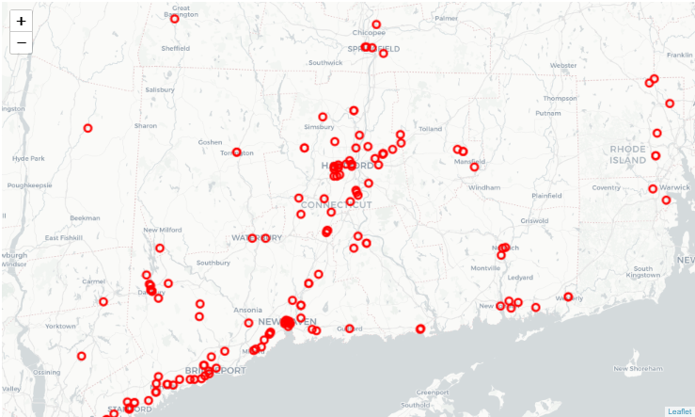
Location with Indian restaurant business

Slide 4
Top cities with No Indian restaurants
City | Population | Restaurant Count
Bristol | 60218 | 0
West Haven | 54763 | 0
Stratford | 52120 | 0
Enfield | 44143 | 0
Trumbull | 35976 | 0
Naugatuck | 31347 | 0
Newington | 30234 | 0
Cheshire | 29147 | 0
East Haven | 28742 | 0
Mansfield | 25799 | 0
Farmington | 25528 | 0
Ridgefield | 25042 | 0
Windham | 24655 | 0
Watertown | 21751 | 0
New Canaan | 20276 | 0
Southbury | 19681 | 0
Waterford | 18935 | 0
Montville | 18835 | 0

Slide 5
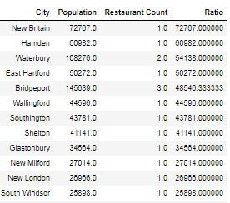
City with high ration (population per Indian restaurants)

Slide 6
Thank you

